Slide 1
What is the 16 Days of Activism Campaign?

Slide 2
Acknowledgment
We are intersectional in our approach and are proud to stand beside generations of great women whose work has brought us closer to equality for all.
We acknowledge the wisdom, living culture and connection of the Traditional Custodians of the lands on which we work, and acknowledge the proof und disruption of colonisation and the Stolen Generations on Aboriginal and Torres Strait Islander peoples.
We believe in shared and just cultural transformation that embraces diversity, and these acknowledgements are part of the ethical principles that guide our work and conduct.

Slide 3
What is the 16 Days Campaign?
The 16 Days Campaign is a global call to action that recognises that gender-based violence (GBV) is a fundamental violation of human rights.
The campaign:
starts on November 25, the International day for the Elimination of Violence Against Women
ends on December 10, World Human Rights Day
these dates were chosen to link violence against women and human rights
was launched in 1991 by the Centre for Women’s Global Leadership.

Slide 4
What are the Aims of the 16 Days Campaign?
raise awareness about gender-based violence as a human rights issue​
strengthen local work around gender-based violence
establish a clear link between local and international work to end gender-based violence
provide a forum in which we can all develop and share new and effective strategies​
demonstrate the solidarity of women around the world against gender-based violence
create tools to influence governments to implement commitments to eliminate gender-based violence

Slide 5
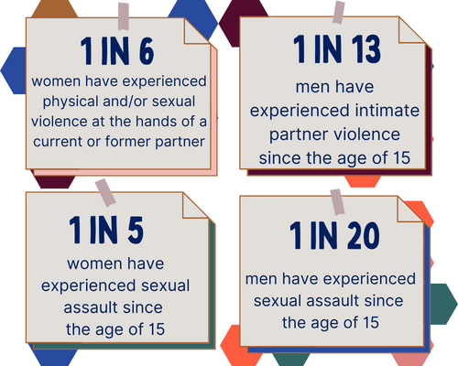
Statistics to be Aware of

Slide 6
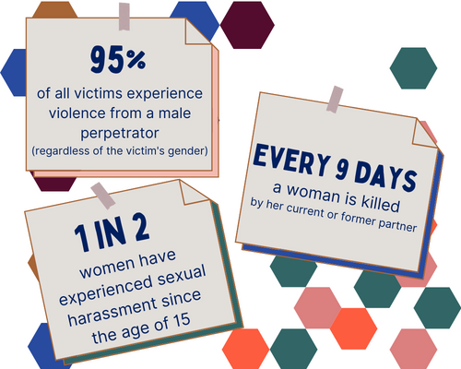
Statistics to be Aware of

Slide 7
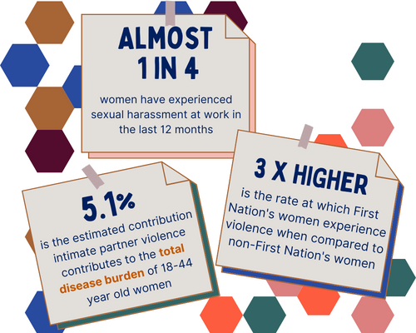
Statistics to be Aware of

Slide 8
Global Culture of Discrimination Against Women
Globally, gender-based violence against women occurs at alarming rates. Too often it's accepted as normal behaviour and the global culture of discrimination against women allows violence to occur largely unchecked.​

Slide 9
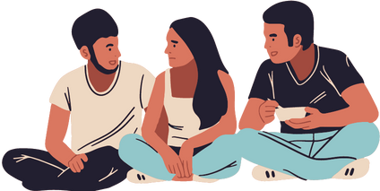
What is Gender-Based Violence?
The term gender-based violence describes violence rooted in gender-based power, inequality and discrimination. It can cause physical, sexual, psychological or financial harm; and it can occur in the home, at work, online or in public.
People of all genders can experience gender-based violence, including transgender and/or non-binary people. Gender-based violence is sometimes used interchangeably with ‘violence against women’ because of the disproportionate number of women and girls who experience violence.

Slide 10
Why do we Need 16 Days of Activism?
The information presented on the next page is from the general Australian population and demonstrates the pervasiveness of the issue - indicating that it does not discriminate.
It also shows that certain gendered patterns in the data are important to note, to be able to develop tailored responses.

Slide 11
The Data Tells us That...
in Australia, the most unsafe place for a woman, is her own home
women are at greater risk of family, domestic and sexual violence than men – and they are more likely to know the perpetrator (often their current or a previous partner) with the violence usually taking place in their home
men experience violence too, but are more likely to experience violence from strangers in a public place

Slide 12
and…
on a national level, gender-based violence against women and their children costs Australia $22 billion each year. Costs include individual costs associated with pain and suffering, property damage and loss of income due to being absent from work, and costs to the health, social and justice systems
one in six women have experienced physical and/or sexual violence at the hands of a current or former cohabiting partner. This is compared to one in 16 men. It amounts to one police call out every two minutes and on average, in Australia, one woman is murdered every nine days by a current or former partner. ​
Campaigns like the 16 Days of Activism are crucial because they shine a spotlight on the issue of gender-based violence and highlight what needs to change to prevent it.

Slide 13
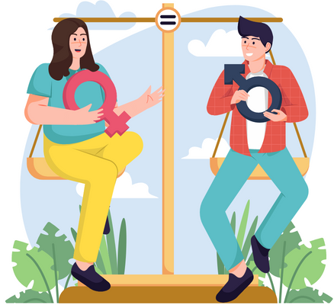
Gender Inequality and Violence Against Women
Gender inequality is the root cause of gender-based violence. We can achieve gender equality through active learning, conscious decisions, respectful behaviour and by eliminating unconscious bias at home, at work and in the community.

Slide 14
It's a Global Problem
Gender-based violence is a global problem that requires global action!
You may get the sense that because it’s such a widespread issue that there isn’t much individuals can do in their own local area. However, here’s the good news: gender-based violence is preventable and promoting and normalising gender equality is at the heart of the solution. This is captured in an evidenced based national framework called Change the Story, developed by Our Watch.
A common saying is not every act of disrespect leads to violence, but every act of violence starts with disrespect.​

Slide 15
Everyone has a Role to Play
Research has found that when there are unequal power relations, and unequal value and respect shown to men, women and gender diverse people, these create broader conditions in society that produce violence.​
So to address gender inequality as the root cause of the problem, we must look beyond the individual, and at the broader culture that may subtly shape attitudes towards violence. ​
​​
A long-term approach is needed to achieve cultural change, however many small actions can make a big difference collectively. Everyone has a role to play in challenging harmful stereotypes, norms and structures that perpetuate inequality and disrespect.
Because when gender equality exists, we all benefit.

Slide 16
The Victorian Campaign
The Victorian Campaign is coordinated by Safe and Equal, in partnership with Respect Victoria, to deliver and support local community engagement with the 16 days of Activism's yearly theme. In 2022 the Victorian theme is Respect Women: Call it Out (Respect Is) to encourage people to choose to lead with respect in their relationships, workplaces, schools, universities, and homes, which can ultimately prevent family violence and gender-based violence.

Slide 17
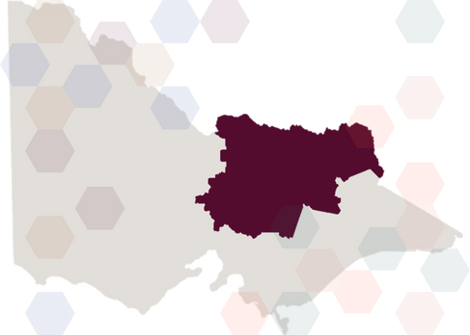
Goulburn Valley and North East Victoria
This year Women’s Health Goulburn North East (WHGNE) are happy to support our community and gender equity partners through the launch of the WHGNE Learning Management System.
Throughout the 16 Days of Activism, stakeholders and the community can access resources via this digital hub to build knowledge and encourage meaningful action to progress gender equality and create the conditions necessary to prevent gender-based violence in our homes, our workplaces, institutions and communities.

Slide 18
How you can get Involved
Attend a local 16 Days event, online or socially distanced.
Join the walk against family violence. Register online at Safe Steps
Follow us on Facebook, Instagram or LinkedIN and re-share our posts
Start the conversation around weaving women’s rights and gender equality into the everyday life of your team, staff and work culture. Try the same at home!

Slide 19
Cultural Change
Cultural change is integral to preventing gender-based violence; that's why the 16 Days of Activism is a great event on the calendar - it puts a spotlight on gender-based violence whilst encouraging cultural change on local, national and global levels.

Slide 20
Further Reading
Take a look at the following websites for further information about the 16 Days of Activism Campaign and other information relating to gender-based violence.
16 Days Campaign
Respect Victoria
Women's Health Goulburn North East
Our Watch
ANROWS

Slide 21
Support Numbers
Reach out to your colleagues, supervisor, manager or access your organisations Employee Assistance Program (EAP).
000 - Urgent Assistance The Orange Door - 1800 271 157 - Family violence in Oven's Murray and all of Victoria - available 9am to 5pm Monday to Friday
Safe Steps - 1800 015 188 - Family violence support for Victorians - available 24/7.
1800 RESPECT - 1800 737 732 - National sexual assault, family and domestic violence counselling line - available 24/7.
No To Violence - 1300 766 491 - Anonymous men's referral service for men who use violence
With Respect - 1800 542 847 - Specialist LGBTIQ+ family violence service - available 9am to 5pm Monday to Friday
Lifeline - 13 11 14 - Mental health support - available 24/7
VACCA – (03) 5756 9000 - Family Violence Client Service Delivery (Case Management) - Ovens Murray
13 YARN - (13 92 76) - National crisis support line for mob - available 24/7

Slide 22
w: www.whealth.com.au
e: whealth@whealth.com.au
p: (03) 5722 3009

